Slide 1

SUNSTROKE PROTECTION SYSTEM FOR OUTSIDE WORKERS
By
GOBIKA M (22EC021)
P S R Engineering College, Sivakasi - 626140

Slide 2

Problem Statement Abstract Introduction Objectives Key Features Technologies Used Flow Chart Benefits
Content

Slide 3
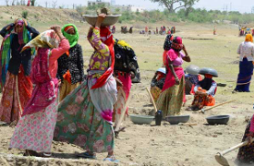
Abstract
The Sunstroke Protection System for Outside Workers monitors real-time temperature and worker conditions to prevent heat-related illnesses. It provides smart alerts, suggests break times, and recommends safe paths to ensure worker safety in extreme weather conditions.

Slide 4

Problem Statement
Outdoor workers are at high risk of sunstroke due to prolonged exposure to extreme temperatures. This system aims to monitor worker conditions in real-time, assess heat risk, and provide smart alerts for breaks and hydration to prevent sun-related health issues.

Slide 5
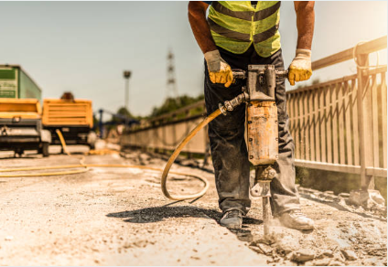
Introduction
Sunstroke is a serious concern for outdoor workers.
Prolonged exposure to high temperatures can lead to heat exhaustion and heatstroke.
This system aims to monitor worker conditions and provide timely alerts for safety.

Slide 6
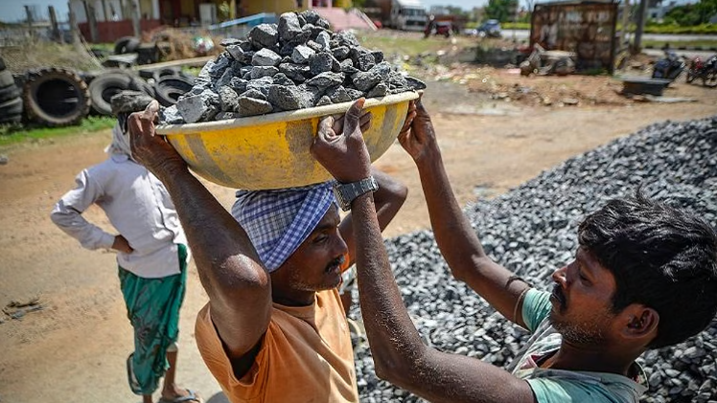
Objectives
Monitor workers' temperature and location in real-time.
Identify high-risk zones and suggest safer paths.
Recommend break times and hydration alerts.
Reduce sunstroke incidents and improve workplace safety.

Slide 7
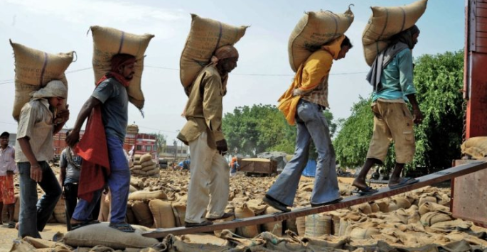
Key Features
- Real-time temperature and location monitoring
- Safe path and break time calculation
- Health alerts and hydration reminders
- User-friendly interface with automated suggestions

Slide 8
Technologies Used
1
2
3
Programming Language:
Data Structures:
Algorithms:
Java Language using various data structures and algorithms to address the problem
Graphs
Queues
Sliding Window
Dijkstra’s Algorithm
Heat Index Calculation

Slide 9

Flow Chart
A step-by-step process of how the system works.
Data Collection
Monitoring
Alerts & Recommendation
Risk Assessment
Decision Making

Slide 10
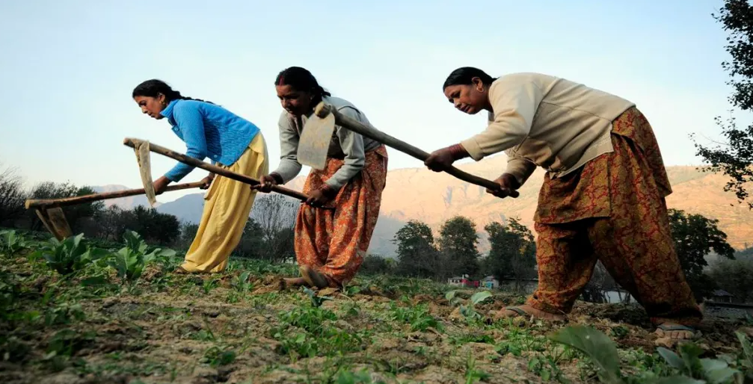
Benefits
Reduces sunstroke-related incidents.
Improves worker productivity by preventing exhaustion.
Enhances worker safety and well-being.
Provides accurate data for employers to implement better safety policies.

Slide 11
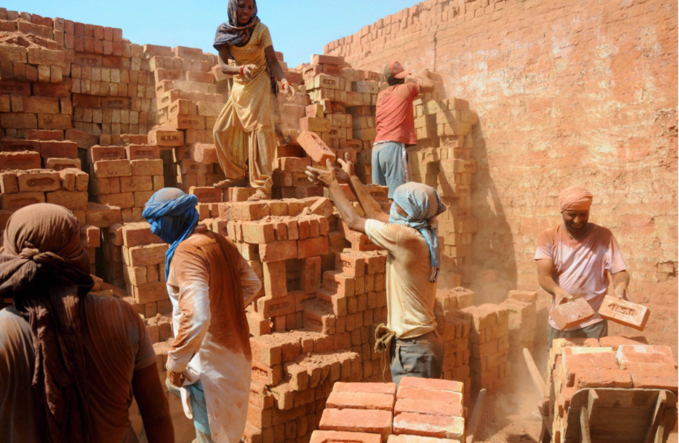
Thank you!

